Slide 1
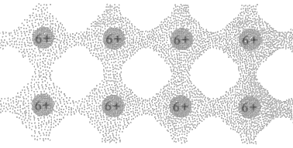
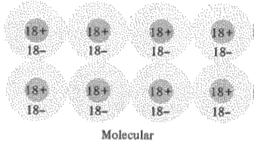
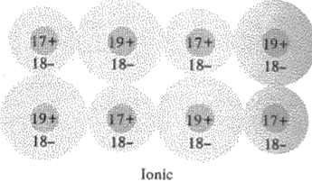
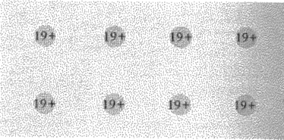
Comparing Charge Densities
Covalent crystals have large interstitial charge density called bonds
Molecular crystals (noble gases) have filled shells, and are extremely tight-binding solids (~spherical).
Ionic crystals composed of a metallic and a nonmetallic element and share electrons (also bond)
Compare to metals (even distribution)
Notes:
Ignore the gradient (bad scanning job)
Distinction less clear, which of course was part of the motivation for focusing on k space
Actually, with a metal, some of the electrons are tightly bound and just shield some of this nuclear charge

Slide 2
Types of Bonds Expected? (In groups)
Krypton
Lithium Iodide
Palladium
Silicon
Indium Antimony (InSb)
Notes:
If it’s a single element, it is not ionic.
Noble gases have no electrons to take part in ionic, covalent or metallic, so van der Waals
Ionic
Metallic
Covalent, four valence electrons
Covalent, group 3 and group 5 elements (The electronegative of Sb is only a little higher than for In)

Slide 3
One last bond we will consider

Slide 4
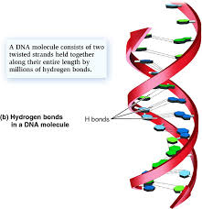
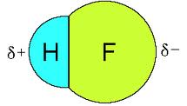
Hydrogen Bonding
To motivate hydrogen bonding, consider a prior example. We said that HF is a covalent bond. Why not ionic?
F: 1s²2s²2p_{x}²2p_{y}²2p_{z}¹

Slide 5
Hydrogen “Bonding”
Comes from the fact that it’s pretty hard (13.6eV) to completely remove an electron from hydrogen
Notes:
About 1/10 the strength of a covalent bond usually oxygen, nitrogen or fluorine Read more : http://www.ehow.com/facts_5982030_covalent-vs_-hydrogen-bonds.html

Slide 6
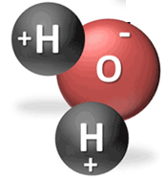
Hydrogen “Bonding”
Usually with oxygen, fluorine or nitrogen (what do they have in common?)
Comes from the fact that it’s pretty hard (13.6eV) to completely remove an electron from hydrogen
Notes:
These elements want electrons to fill their outer orbital
About 1/10 the strength of a covalent bond usually oxygen, nitrogen or fluorine Read more : http://www.ehow.com/facts_5982030_covalent-vs_-hydrogen-bonds.html

Slide 7
Hydrogen “Bonding”
What kind of bond forms in a single molecule of H and O?
Usually with oxygen, fluorine or nitrogen (what do they have in common?)
Comes from the fact that it’s pretty hard (13.6eV) to completely remove an electron from hydrogen
Notes:
Covalent
About 1/10 the strength of a covalent bond usually oxygen, nitrogen or fluorine Read more : http://www.ehow.com/facts_5982030_covalent-vs_-hydrogen-bonds.html

Slide 8
Hydrogen “Bonding”
What kind of bond forms in a single molecule of H and O?
Usually with oxygen, fluorine or nitrogen (what do they have in common?)
Comes from the fact that it’s pretty hard (13.6eV) to completely remove an electron from hydrogen
What happens if you bring in another H₂O molecule?
Notes:
About 1/10 the strength of a covalent bond usually oxygen, nitrogen or fluorine Read more : http://www.ehow.com/facts_5982030_covalent-vs_-hydrogen-bonds.html

Slide 9
Hydrogen “Bonding”
What kind of bond forms in a single molecule of H and O?
Usually with oxygen, fluorine or nitrogen (what do they have in common?)
Comes from the fact that it’s pretty hard (13.6eV) to completely remove an electron from hydrogen
Is this arrangement likely?
What happens if you bring in another molecule?
Notes:
About 1/10 the strength of a covalent bond usually oxygen, nitrogen or fluorine Read more : http://www.ehow.com/facts_5982030_covalent-vs_-hydrogen-bonds.html

Slide 10
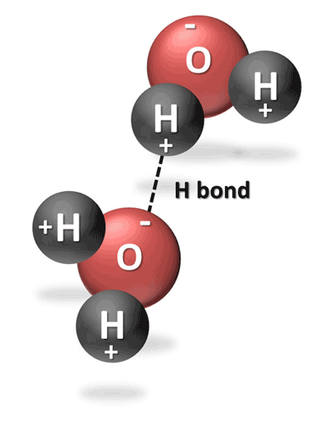
Hydrogen “Bonding”
What kind of bond forms in a single molecule of H and O?
Usually with oxygen, fluorine or nitrogen (what do they have in common?)
Comes from the fact that it’s pretty hard (13.6eV) to completely remove an electron from hydrogen
In H₂0, hydrogen covalently bonds with nearby oxygen, but it also has a hydrogen bond with the next nearest neighbor.
Is this arrangement likely?
What happens if you bring in another molecule?
Notes:
About 1/10 the strength of a covalent bond usually oxygen, nitrogen or fluorine Read more : http://www.ehow.com/facts_5982030_covalent-vs_-hydrogen-bonds.html

Slide 11
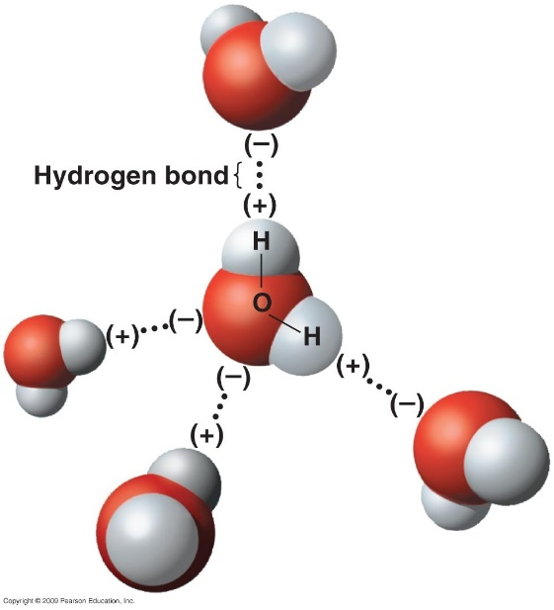
Hydrogen “Bonding”
What kind of bond forms in a single molecule of H and O?
Usually with oxygen, fluorine or nitrogen (what do they have in common?)
Comes from the fact that it’s pretty hard (13.6eV) to completely remove an electron from hydrogen
In H₂0, hydrogen covalently bonds with nearby oxygen, but it also has a hydrogen bond with the next nearest neighbor.
Since the electron is pulled toward the closer oxygen, the positive charge is on the outside and attracted to other negative oxygens.
What happens if you bring in another molecule?
Notes:
About 1/10 the strength of a covalent bond usually oxygen, nitrogen or fluorine Read more : http://www.ehow.com/facts_5982030_covalent-vs_-hydrogen-bonds.html

Slide 12
Before we move onto phonons, we need to at least briefly discuss strian

Slide 13
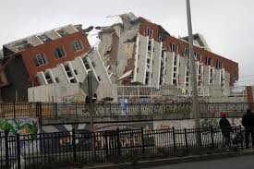
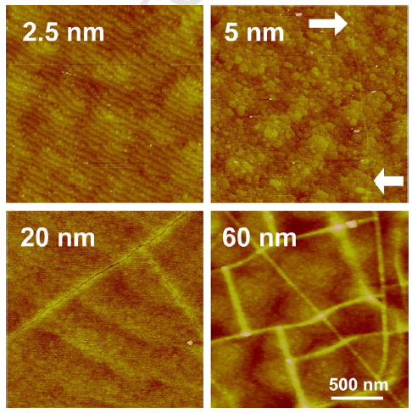
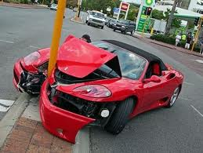
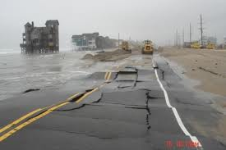
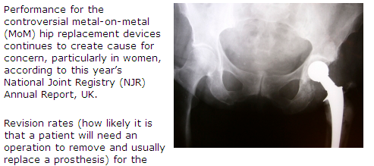
Stress & Strain (e.g., smooth films, glass, roads, airplane wings, medical inserts, building materials, etc.)
Notes:
This lecture starts easy, but then gets more challenging toward the end. (It would be nice to reverse that if I could think of a way to still make it make sense. No ideas right now.) (Consider adding a brief discussion of slip planes, on page 103 of Holgate)
Mention my husband’s neck disk, can feel when it’s about to rain, would be a good weatherman
Light waves will also cause vibrations in the sample, related to how easily the atoms compress

Slide 14
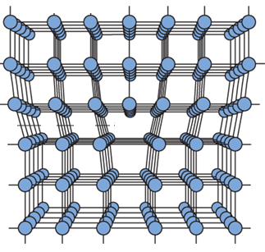
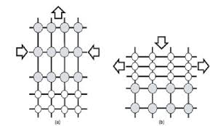
Stress/Strain
Compressive Tensile
The tensile strain (pulling out on the top layer) or the opposite compressive strain can dramatically affect material properties.
Notes:
The change in the film and bulk lattice parameter divided by the bulk lattice parameter.
Spin density wave
Fundamentally SDWs involve the development of a superstructure in the form of a periodic modulation in the density of the electronic spins with a characteristic spatial frequency. The new periodicity can be observed neutron diffraction or susceptibility measurements. Occur at low temperature in anisotropic, low-dimensional materials or in metals that have high densities of states at the Fermi level.
First-principles study on the phase diagram and multiferroic properties of (SrCoO₃)₁/(SrTiO₃)₁ superlattices
Guang Song
& Weiyi Zhang
Scientific Reports 4, Article number: 4564 (2014)
doi:10.1038/srep04564

Slide 15
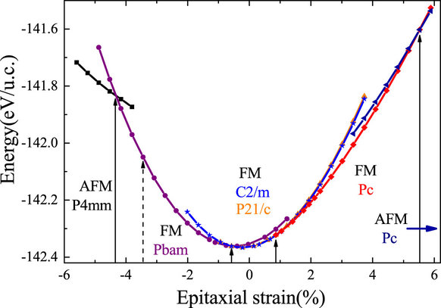
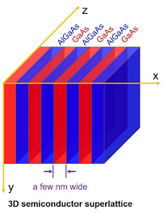
Stress/Strain
SrCoO₃/SrTiO₃ superlattices
Compressive Tensile
The tensile strain (pulling out on the top layer) or the opposite compressive strain can dramatically affect material properties.
Notes:
The change in the film and bulk lattice parameter divided by the bulk lattice parameter.
Spin density wave
Fundamentally SDWs involve the development of a superstructure in the form of a periodic modulation in the density of the electronic spins with a characteristic spatial frequency. The new periodicity can be observed neutron diffraction or susceptibility measurements. Occur at low temperature in anisotropic, low-dimensional materials or in metals that have high densities of states at the Fermi level.
First-principles study on the phase diagram and multiferroic properties of (SrCoO₃)₁/(SrTiO₃)₁ superlattices
Guang Song
& Weiyi Zhang
Scientific Reports 4, Article number: 4564 (2014)
doi:10.1038/srep04564

Slide 16
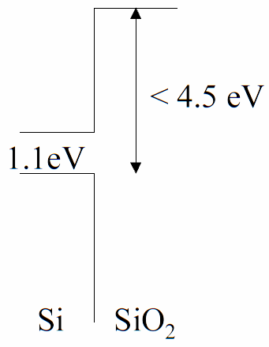
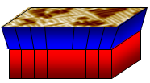
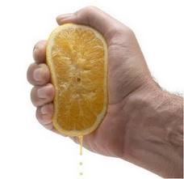
Strain Application: Fast Computers
Gordon Moore predicted that the number of transistors on a microchip would double every two years.
Industry found that it could improve the carrier dynamics in MOSFETs by straining the silicon.

Slide 17
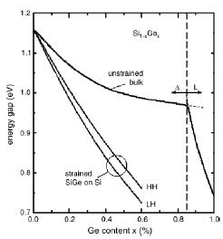
Strain Application: Fast Computers
Gordon Moore predicted that the number of transistors on a microchip would double every two years.
Industry found that it could improve the carrier dynamics in MOSFETs by straining the silicon.
Strain can affect energy gaps in a manner that allows quicker, more efficient transfer of electrons.
Strain can also affect other properties of a material.

Slide 18
Solids
Like a spring, the shape of an object will return if a small force is applied. Why?
Stress is force per unit area causing a deformation (change in length/shape/volume).
F
Cat head
Stress = Force / Contact Area
Notes:
In addition to move objects, we can change their shap by applying a force.

Slide 19
Solids
Like a spring, the shape of an object will return if a small force is applied.
Stress is force per unit area causing a deformation (change in length/shape/volume).
Strain is a measure of the amount it’s deformed when a force is applied.
F
Cat head
Stress = Force / Contact Area
Notes:
In addition to move objects, we can change their shap by applying a force.

Slide 20
Elasticity vs Plasticity
While elastic deformation occurs on the atomic level by the bonds connecting atoms stretching, plastic deformation involves the bonds between atoms breaking. New bonds are formed when they move to a new position.

Slide 21
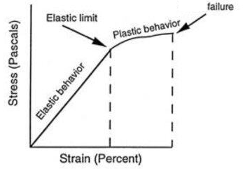
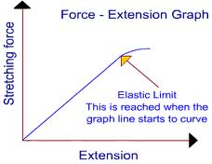
Elasticity vs Plasticity
While elastic deformation occurs on the atomic level by the bonds connecting atoms stretching/compressing, plastic deformation involves the bonds between atoms breaking. New bonds may be formed when they move to a new position.
F_{S} = -kx (Hooke’s Law)
k is the effective spring constant
F_{s}=
slope=k
(x)

Slide 22
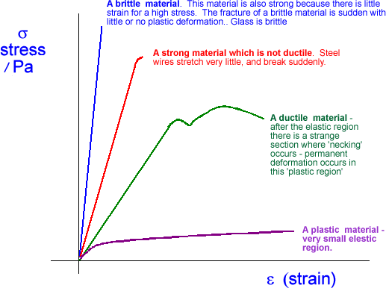
How would you describe these materials?
Notes:
Before showing descriptions: Which side corresponds with brittleness?
Ductile means able to be drawn out into a thin wire. Steel strings used on guitars will break if tightened too much.
The spring is an analogy. In reality the material of the spring can stretch out too, not just the curves getting stretched.

Slide 23
How would you describe these materials?
Which do you think is brittle?
Notes:
Before showing descriptions: Which side corresponds with brittleness?
Ductile means able to be drawn out into a thin wire. Steel strings used on guitars will break if tightened too much.
The spring is an analogy. In reality the material of the spring can stretch out too, not just the curves getting stretched.

Slide 24
How would you describe these materials?
What kind of bonds are brittle?
Which do you think is brittle?
Notes:
Before showing descriptions: Which side corresponds with brittleness? (Ionic and covalent bonds are brittle.)
Ductile means able to be drawn out into a thin wire. Steel strings used on guitars will break if tightened too much.
The spring is an analogy. In reality the material of the spring can stretch out too, not just the curves getting stretched.

Slide 25
How would you describe these materials?
Which do you think is brittle?
Notes:
Before showing descriptions: Which side corresponds with brittleness?
Ductile means able to be drawn out into a thin wire. Steel strings used on guitars will break if tightened too much.
The spring is an analogy. In reality the material of the spring can stretch out too, not just the curves getting stretched.

Slide 26
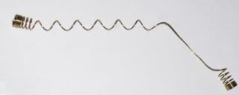
How would you describe these materials?
Which do you think is brittle?
Notes:
Before showing descriptions: Which side corresponds with brittleness?
Ductile means able to be drawn out into a thin wire. Steel strings used on guitars will break if tightened too much.
The spring is an analogy. In reality the material of the spring can stretch out too, not just the curves getting stretched.

Slide 27
How would you describe these materials?
Which do you think is brittle?
Notes:
Before showing descriptions: Which side corresponds with brittleness?
Ductile means able to be drawn out into a thin wire. Steel strings used on guitars will break if tightened too much.
The spring is an analogy. In reality the material of the spring can stretch out too, not just the curves getting stretched.

Slide 28
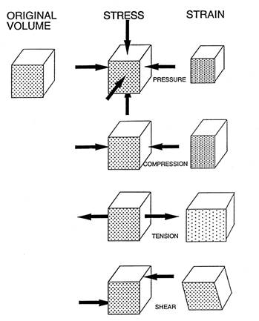
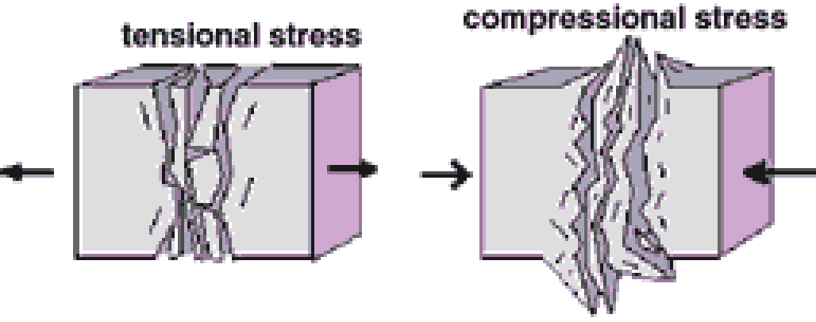
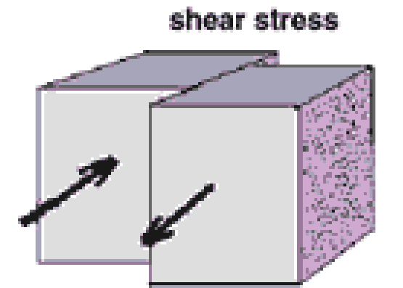
What can happen to the dimensions of an object when you put stress on it?
Change in Length
Change in Shape and/or break bonds

Slide 29
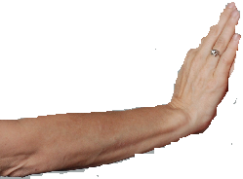
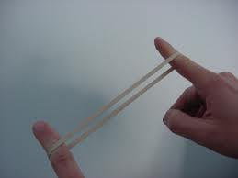
Elasticity in Length Pushing atoms closer together
Fixed wall
σ =
L_{o}
Є =
Area A
$$Yor E=Young^{′}s Modulus$$
σ = Y * Є
A material with a large Y (or E) is difficult to stretch or compress.
What must be the units of stress and Y (or E)?
F
Notes:
Rubber band has a low Y

Slide 30
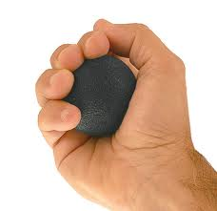
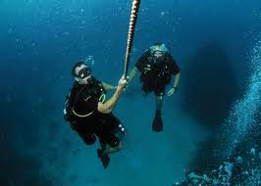
Volume Changes
The shape stays the same.
The bulk modulus characterizes how easy it is to uniformly squeeze a material in all directions. (For example, if you put a material deep in the ocean.)
Notice the negative sign. Makes sense: Increasing the pressure on an object, decreases it volume and vice versa.
Notes:
Increasing the force on an object, also decreases it’s length, so you could rightly argue that it would make sense at least for the tensile formula too. However, that is not the convention.

Slide 31
Physics 101 Example of Stress:
What did we ignore in this exercise?
Directionality
Car Crash: During a car crash, a forearm is slammed against the dashboard.
The arm comes to rest from an initial speed of 80 km/h in 5.0 ms. If the arm has an effective mass of 3.0 kg, what is the compressional stress that the arm withstands during the crash? (The total cross-sectional area of the load-bearing portion of the two forearm bones is approximately 2.4 cm².)
$$stress (σ or e)=\frac{F}{A}=\frac{ma}{A}$$
Notes:
Before we get into more details, let’s look at a simple picture of stress/stain. In a car crash, what information do we need to understand the stress on the bone?
We know bones are more likely to break depending on in what direction the force is applied

Slide 32
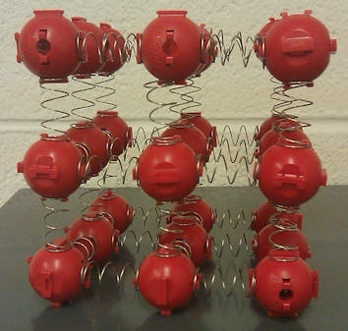
Compression easier along some directions
Real materials are rarely perfectly isotropic, so how do we address this?
Simple cubic
What would you expect to happen if I squeeze on this?
Notes:
It might squeeze. It might buckle. Could be harder to predict for a more complicated structure.

Slide 33
Math Lesson: Tensors
To understand elasticity & deformation in various directions, we need to understand tensors. What is a tensor?
Notes:
Tensors aren’t that complicated. You just need to be introduced to them. You’ve actually met many before, they were just called different things.

Slide 34
Math Lesson: Tensors
To understand elasticity & deformation in various directions, we need to understand tensors. What is a tensor?
Tensors describe linear relations between vectors, scalars, and other tensors.
Notes:
For many materials, the polarization is proportional the the electric field, provided E is not too strong. The constant is the electric susceptibility and is dimensionless. These materials are called linear dielectrics.

Slide 35
Math Lesson: Tensors
To understand elasticity & deformation in various directions, we need to understand tensors. What is a tensor?
Tensors describe linear relations between vectors, scalars, and other tensors.
A tensor can be represented as a multi-dimensional array of numerical values. The rank (also degree or order) of a tensor is the dimensionality of the array needed to represent it, or equivalently, the number of indices needed to label a component of that array (examples on next slides).
Notes:
For many materials, the polarization is proportional the the electric field, provided E is not too strong. The constant is the electric susceptibility and is dimensionless. These materials are called linear dielectrics.

Slide 36
Tensors
Scalar Tensor of rank 0 (magnitude only – 1 component)
- Examples: temperature, length
Vector Tensor of rank 1 (magnitude and one direction – 3 components)
- Examples: magnetization, heat flow, temperature gradient, and electric current
Dyad Tensor of rank 2 (magnitude and two directions – 3² = 9 components)
- Some external stimuli are vectors and give a response that can be described as a vector.
For linear dielectrics, the polarizability tensor:
Notes:
You’ve seen rank 0, 1 and 2 tensors frequently. They just probably weren’t called that. We’d generally just call a rank 2 a matrix, a rank 1 a vector and a rank 0 a scalar.
Chi is the electric susceptibility

Slide 37
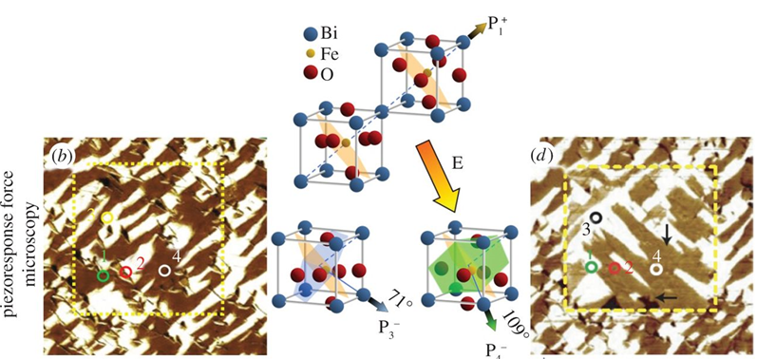
Anisotropy
Tensors become important when materials exhibit anisotropy (and most do).
For example, in an anisotropic material, the application of field E may result in a polarization P that is not parallel to E.
Notes:
Anisotropy: the dependence of properties on direction
Ferroelectric materials are also often ferroelastic. Perhaps they all are? I tried to look it up, but couldn’t find anything.
What is a Ferroelastic?
Ferroelastic crystals are, in some respects, akin to the more familiar ferromagnetic and ferroelectric materials. Instead of spontaneous magnetisation or polarisation, these materials develop a spontaneous strain below a phase transition from paraelastic to ferroelastic. The transition is accompanied by critical behaviour of the elastic compliance (the effective susceptibility for the strain).
Ferroelastic materials are defined by having switchable domains, or twins, which may be switched on application of an external field: stress.
Such domain microstructures often result from phase transitions.

Slide 38
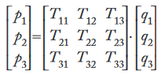
Defining Notation for Tensors (Ranks 1 and 2)
Example:
In general:
means
or
Notes:
You’ve seen rank 0, 1 and 2 tensors frequently. They just probably weren’t called that. We’d generally just call a rank 2 a matrix, a rank 1 a vector and a rank 0 a scalar.

Slide 39
Second-Rank Tensors
Whenever one quantity described by a first-rank tensor depends on another first-rank tensor quantity (such as P and E), the link between the two is described by a second-rank tensor.
Likewise, two rank 2 tensors are related by a rank 4 tensor. And, a rank 1 and rank 2 tensor are related by a rank 3 tensor.
How many components should rank 3 & 4 have?
Notes:
Typically a 3x3 matrix in 3D. Rank 3 is 3X3X3+27. Rank 4=81.
Consider showing example on board of matrix (xx, xy, xz…)(x y z). Maybe insert (0 0 1) for vector.

Slide 40
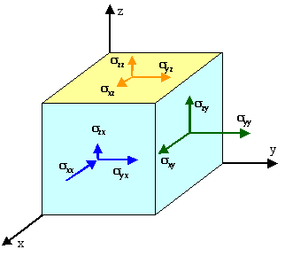
Example tensor
Stress σ arises from applying a force to a surface.
Force is a vector quantity (1st rank tensor).
Then stress is what rank? How about strain?
When you apply force to a surface, you have to consider also the relative orientation of the force vector to the crystallographic directions. A force along one direction will behave differently than a force along another.
Giving both tensile and shear strain reactions.
Notes:
Before finishing this slide, you might expect strain to be a second rank tensor, based on the fact that force is a vector. However, it’s a lot more complicated. I want you to at least understand why it’s so complicated. I’m not likely to ask stress/strain tensor math questions on a test. I could ask general conceptual questions however.

Slide 41
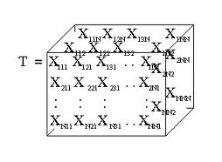
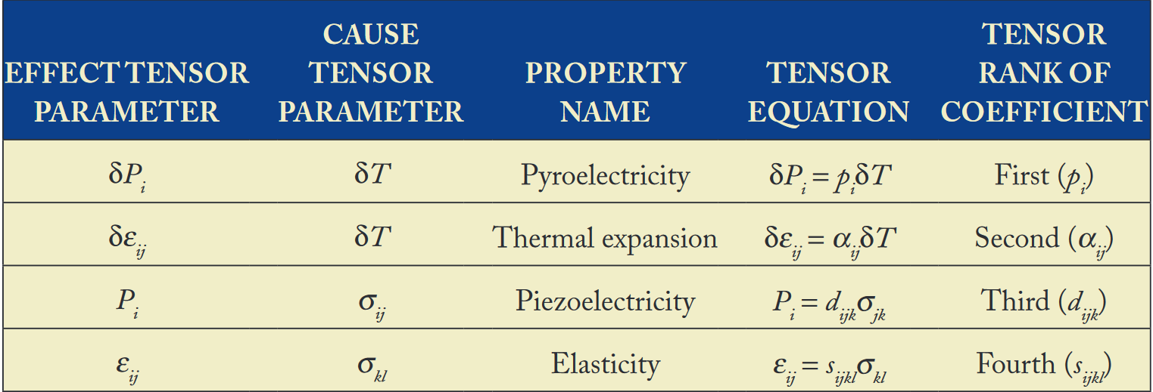
Tensors
Higher-rank tensors can describe the effect of an applied stimulus (like a magnetic/electric field, call these field tensors) to physical properties (matter tensors).
Notes:
So piezoelectricity is a 3rd order, or effect of an applied stimulus

Slide 42
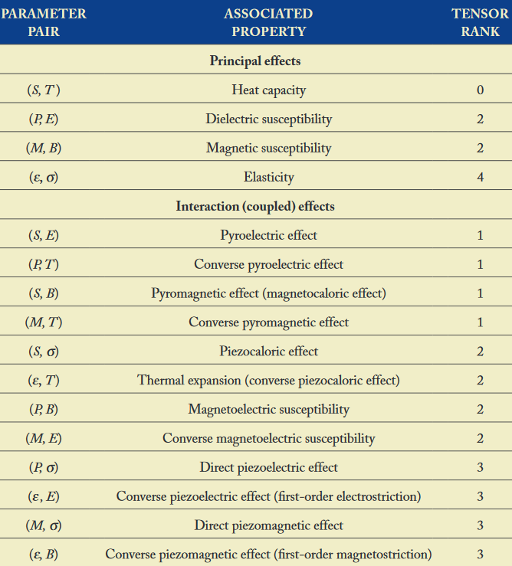
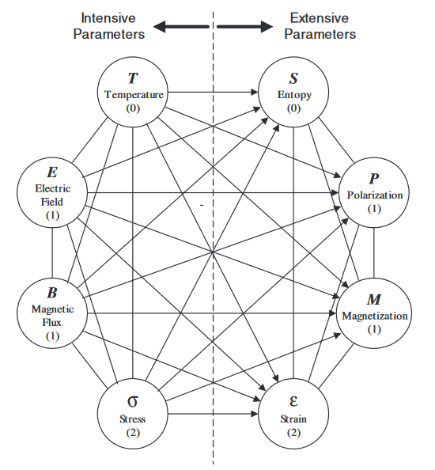
Tensors
Higher-rank tensors can describe the effect of an applied stimulus (like a magnetic/electric field, call these field tensors) to physical properties (matter tensors).
Notes:
So piezoelectricity is a 3rd order, or effect of an applied stimulus

Slide 43
Tensors
Higher-rank tensors describe effect of a stimulus (field tensors) to properties (matter tensors).
Matter tensors often appear as if they are constants of the material, but they can be modified by the application of a field tensor.
The form of matter tensors are determined by symmetry. Field tensors can sometimes change this symmetry.

Slide 44
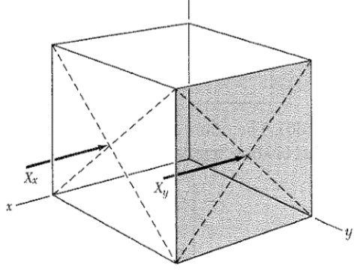
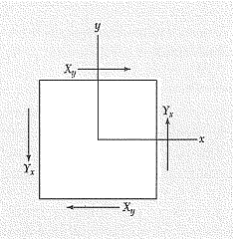
Stress Components
In an elastic body there are restoring forces if deformation takes place. These forces can be seen as acting on planes inside the body. Forces divided by an area are called stresses.
In order for the deformed body to remain deformed these forces have to compensate each other. We will see that the relationship between the stress and the deformation (strain) is linear and can be described by tensors.
9 stress components: X_{x}, X_{y}, X_{z}, Y_{x}, Y_{y}, Y_{z}, Z_{x}, Z_{y}, Z_{z} (commonly written as σ)
Capital letter is direction of force, lower case indicates the normal to the plane to which the force is applied

Slide 45
Another notation for the stress tensor
3
The stress tensor describes the forces acting on planes within a body. Due to the symmetry condition
2
22
21
23
Voigt notation
1
there are only six independent elements.
The vector normal to the corresponding surface
The direction of the force vector acting on that surface
Notes:
We further simplify this xy to one number because of the next slide

Slide 46
Compliance and Stiffness Constants
In highly anisotropic materials, any one component of stress can cause strain ε in all six components.
For the generalized case, Hooke’s law may be expressed as:
where,
Both S_{ijkl} and C_{ijkl} are fourth-rank tensor quantities.
Expansion of either equations above will produce nine (9) equations, each with nine (9) terms, leading to 81 constants in all.
Both σ_{ij} and ∈_{ij} are symmetric tensors (off diagonal ij=ji)
$$σ_{i}=C_{ij}{\text{∈}}_{j} \\ {\text{}}_{i}=S_{ij}σ_{j}$$
(7-1)
(7-2)
Yes counterintuitive letters!
Notes:
Stress = stiffness * strain (compare to simple version we discussed before)

Slide 47
The direct consequence of the symmetry in the stress and strain tensors is that only 36 components of the compliance tensor are independent and distinct terms.
Similarly, only 36 components of the stiffness tensor are independent and distinct terms.
$$σ_{i}=C_{ij}{\text{∈}}_{j} \\ {\text{}}_{i}=S_{ij}σ_{j}$$

Slide 48
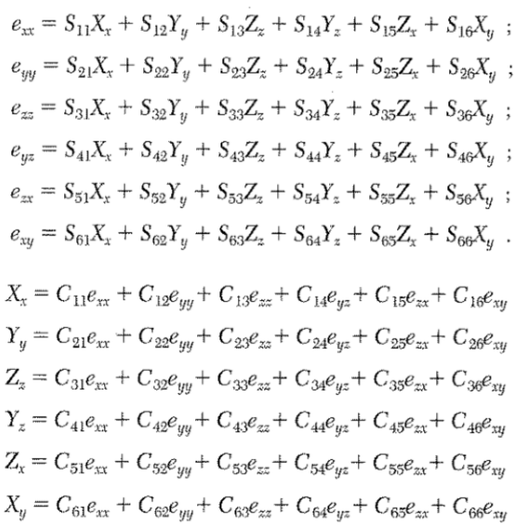
Hooke’s law states proportional if small stress
Using Voigt notation:
S’s are elastic compliance constants and C’s are elastic stiffness constants.
No, I don’t have these backwards!
Notes:
e and sigma both are common variables for strain

Slide 49
In matrix format, the stress-strain relation showing the
36 (6 x 6) independent components of stiffness can be
represented as:
$$\left(\begin{matrix}σ_{1} \\ σ_{2} \\ σ_{3} \\ σ_{4} \\ σ_{5} \\ σ_{6}\end{matrix}\right)=\left(\begin{matrix}C_{11} & C_{12} & C_{13} & C_{14} & C_{15} & C_{16} \\ C_{21} & C_{22} & C_{23} & C_{24} & C_{25} & C_{26} \\ C_{31} & C_{32} & C_{33} & C_{34} & C_{35} & C_{36} \\ C_{41} & C_{42} & C_{43} & C_{44} & C_{45} & C_{46} \\ C_{51} & C_{52} & C_{53} & C_{54} & C_{55} & C_{56} \\ C_{61} & C_{62} & C_{63} & C_{64} & C_{65} & C_{66}\end{matrix}\right)\left(\begin{matrix}{\text{}}_{1} \\ {\text{}}_{2} \\ {\text{}}_{3} \\ {\text{}}_{4} \\ {\text{}}_{5} \\ {\text{}}_{6}\end{matrix}\right)$$
$σ_{i}=C_{ij}{\text{∈}}_{j}$ and ${\text{}}_{i}=S_{ij}σ_{j}$
Or in short notation:
Are all 36 independent?

Slide 50
$$\left(\begin{matrix}σ_{1} \\ σ_{2} \\ σ_{3} \\ σ_{4} \\ σ_{5} \\ σ_{6}\end{matrix}\right)=\left(\begin{matrix}C_{11} & C_{12} & C_{13} & C_{14} & C_{15} & C_{16} \\ C_{21} & C_{22} & C_{23} & C_{24} & C_{25} & C_{26} \\ C_{31} & C_{32} & C_{33} & C_{34} & C_{35} & C_{36} \\ C_{41} & C_{42} & C_{43} & C_{44} & C_{45} & C_{46} \\ C_{51} & C_{52} & C_{53} & C_{54} & C_{55} & C_{56} \\ C_{61} & C_{62} & C_{63} & C_{64} & C_{65} & C_{66}\end{matrix}\right)\left(\begin{matrix}{\text{}}_{1} \\ {\text{}}_{2} \\ {\text{}}_{3} \\ {\text{}}_{4} \\ {\text{}}_{5} \\ {\text{}}_{6}\end{matrix}\right)$$
But only one-half of the non-diagonal terms are independent constants since Cij = Cji
Independent terms

Slide 51
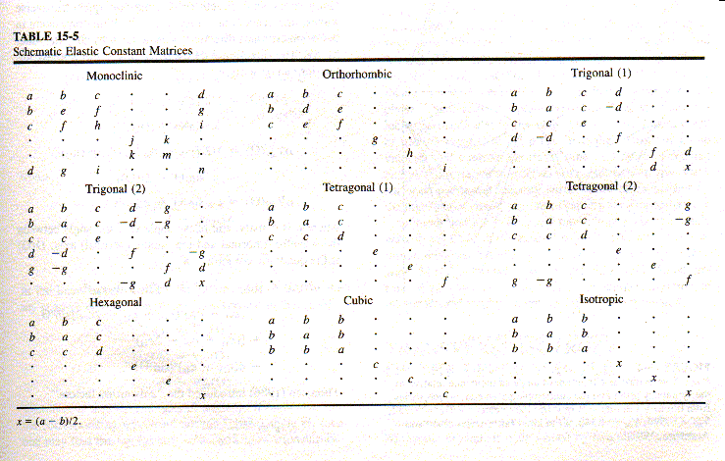
Elastic anisotropy – tensor elements

Slide 52
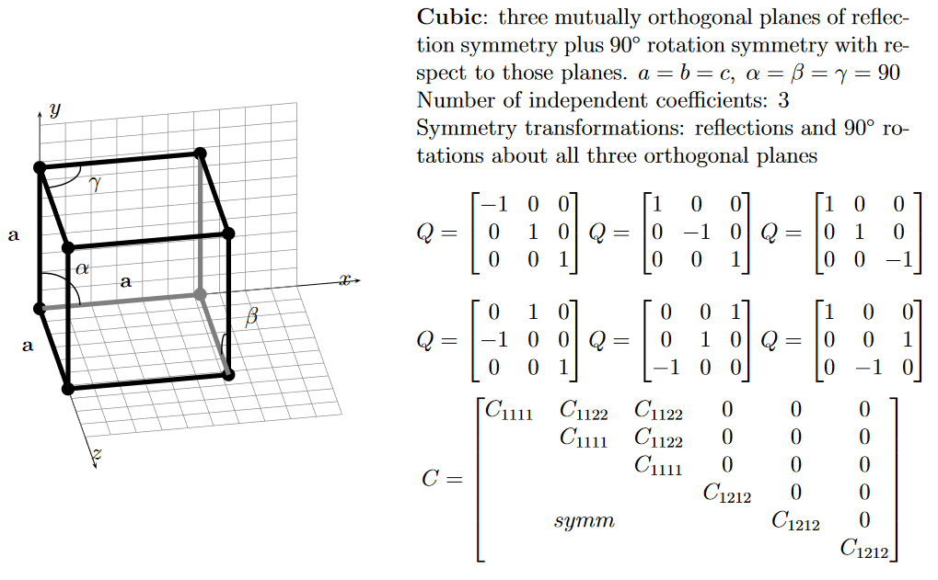
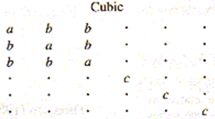
With some thought, it is easy to see that the elastic tensor must have this form. The cubic axes are equivalent, so the diagonal components for normal and shear distortions must be equal.
Notes:
Matrices listed here are the different symmetry operations for cubic

Slide 53
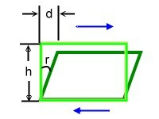
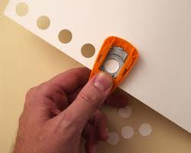
Changes in Shape Bending or breaking bonds
Δx
The volume stays the same
in this type of stress.
(e.g., punching out a hole in paper or wall)
CS
In shear stress, the applied force is parallel to the cross-sectional area. (In tensile stress, the force is ⊥ to CS area.)
What is the shear cross-sectional area of the missing paper?
A. πr² B. πr²t
C. 2πr D. 2πrt
breaking bonds
CS
A material with a large shear modulus S is difficult to bend.
r
t thickness
Notes:
D
Do we want airplane wings with a big or small shear modulus?

